Slide 1

PhoneNow
TELECOM
COMPANY

Slide 2


PhoneNow
About us
PhoneNow is a telecom company which provides different services to partners, dependents, senior citizens, etc. They want to retain their customer loyalty.

Slide 3
PhoneNow
Challenges
PhoneNow is facing some challenges in retaining back their customers:-
PhoneNow wants to retain back it customers who left within the last month. Currently, we get in touch after they have terminated the contract, but this is reactionary: it would be better to know in advance who is at risk.

Slide 4


Services
PhoneNow
01
Phone Services
02
Internet Service
03
Multiple Line Services
04
Online Security
05
Online backup
06
Tech Support
07
Device Protection
08
Streaming Tv & Movies

Slide 5
PhoneNow
Churn Dashboard

Slide 6
PhoneNow
Churn Count

Slide 7

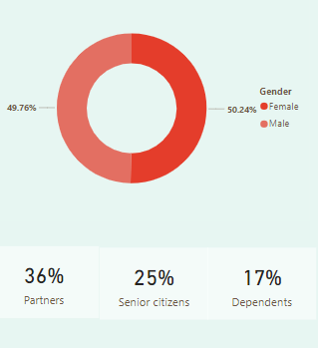

PhoneNow
Demographics
Number of females(939) churned is more than number of males(930) churned.
36%
25%
17%
Partners are churned.
Senior citizens are churned.
Dependents are churned.

Slide 8
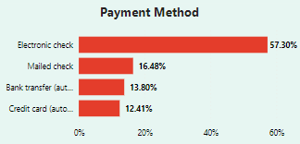
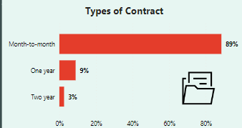
Customer Account Information
PhoneNow
The different payment methods are:-
Electronic Check (1071)
Mailed check (308)
Bank Transfer(automatic) (258)
Credit Card(automatic) (232)
The three types of contract are:-
Month-to-month (Female-842 ,Male-813)
One year (Female-75, Male-91)
Two year (Female-22, Male-26)
Females monthly customer are more likely to churn than male monthly customers.
Males one year and two year customer are more likely to churn than female customers.

Slide 9
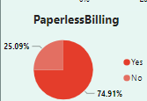

Customer Account Information
PhoneNow
Paperless billing:-
Yes (1400)
No (469)
The average monthly charges the company likely to lose is 74.44
And the average yearly charges the company likely to lose is 1531.80

Slide 10
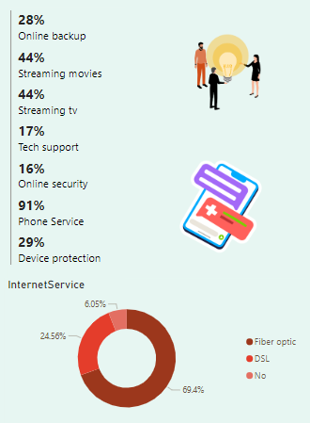
PhoneNow
Service Churn Insights

Slide 11
PhoneNow
Customer Risk Analysis

Slide 12
PhoneNow
Customer Count

Slide 13
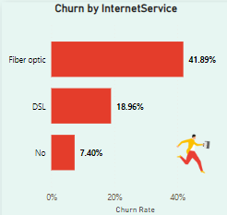
PhoneNow
Churn By Internet Service
Customers Churned by internet service
Fiber optic (3096)
DSL (2421)
No (1526)
Most of the customers churned use fiber optic type of internet service.

Slide 14
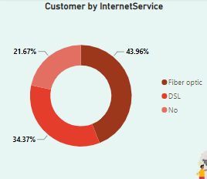
PhoneNow
Customer By Internet Service
Customers that uses internet service
Fiber optic (43.96%)
DSL (34.37%)
No (21.67%)
Most of the customers use fiber optic type of internet service.

Slide 15
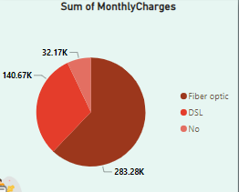
PhoneNow
Sum Of Monthly Charges
Amount Charged by customers using internet service
Fiber optic (62.11%)
DSL (30.84%)
No (7.05%)
Customers pay mostly for fiber optic.

Slide 16
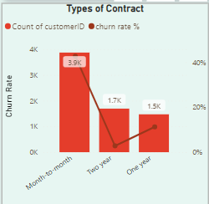
PhoneNow
Types Of Contract
Customers Churned by contract
Month-to-month (42.7%)
Two Year (2.83%)
No (11.27%)
Count of Customers
Month-to-month (3875)
Two Year (1695)
No (1473)
Most of the customers churned used month-to-month type of contract.

Slide 17
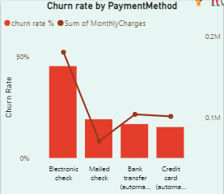
PhoneNow
Churn Rate by Payment Method
Maximum churned customers uses electronic check payment method(45.29%)
Minimum churned customer uses credit card (15.24%)

Slide 18
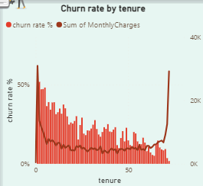
PhoneNow
Churn Rate by Tenure
When the monthly charges was low, percentage of churned customers was fluctuating. The percentage of churn started reducing when sum of monthly charges was greater than 20000.

Slide 19
PhoneNow
Strategies
Strategy 1
Strategy 2
Strategy 3
Increase tech support capacity for Fiber Optic customers and lower tech tickets per customer to 0.5.
Improve Phone service given to the customers as maximum number of churned customers belong to Phone service.
Yearly increase of automatic payments by 5%.

Slide 20
THANK
YOU

